Slide 1


University of Engineering & Management, Kolkata
PARKINSON’S DISEASE PREDICTION USING MACHINE LEARNING
PRESENTED BY
Rupayan Saha
Sarthak Chakraborty
Abir Lal Manna
Debasmita Das

Slide 2




Why Parkinson’s disease prediction using ml?
Early Detection.
High Accuracy.
Multimodal Data Analysis.
Handles Complexity.

Slide 3

Problem Statement
Delayed Diagnosis.
Non-Specific Symptoms.
Lack of Accessibility and Expensive.
Data Complexity.

Slide 4

Proposed Solutions
Feature Extraction.
Machine Learning Model Development.
Multimodal Integration.
Prediction and Probability Scores

Slide 5
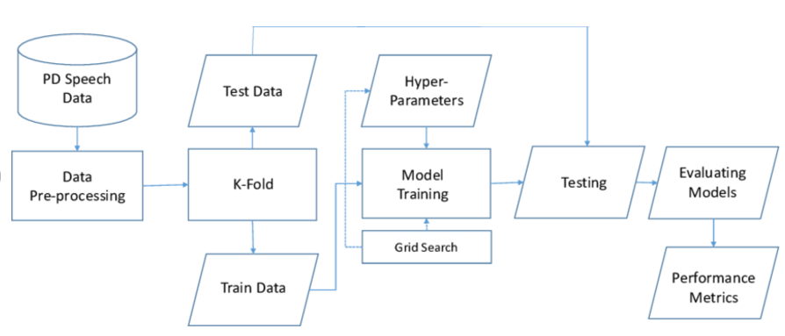

Block diagram of the setup

Slide 6

Features
1. Name - ASCII subject name and recording number
2. MDVP:Fo(Hz) - Average vocal fundamental frequency
3. MDVP:Fhi(Hz) - Maximum vocal fundamental frequency
4. MDVP:Flo(Hz) - Minimum vocal fundamental frequency
5. MDVP:Jitter(%),MDVP:Jitter(Abs),MDVP:RAP,MD VP:PPQ,Jitter:DDP - Several measures of variation in fundamental frequency
6. MDVP:Shimmer,MDVP:Shimmer(dB),Shimmer:APQ3, Shimmer:APQ5,MDVP:APQ,Shimmer:DDA - Several measures of variation in amplitude
7. NHR, HNR - Two measures of ratio of noise to tonal components in the voice

Slide 7
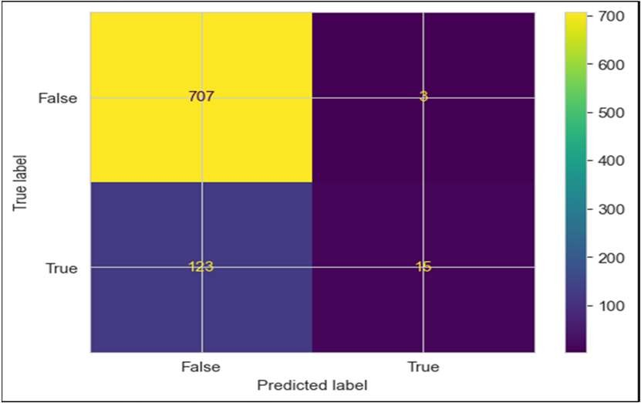
Feature Extraction
COMPONENTS OF CONFUSION MATRIX
True Positive (TP): The number of instances correctly predicted as positive.
True Negative (TN): The number of instances correctly predicted as negative.
False Positive (FP): The number of instances incorrectly predicted as positive when they are actually negative. Also known as a Type I error.
False Negative (FN): The number of instances incorrectly predicted as negative when they are actually positive. Also known as a Type II error.

Slide 8







CLASSIFICATION
01
02 03
04
SVM
SVM is an authorised method of machine
learning that can be used to decipher
systemization and
dire straits of retrogression.
RANDOM FOREST
LOGISTIC REGRESSION
NAÏVE BAYES
Naive Bayes is a simple but powerful
probabilistic classifier based on Bayes'
theorem. It is widely
used in machine learning for
classification tasks, especially in text
classification and spam fi l tering.
. Random Forest is capable of performing both Classification and Regression tasks
Logistic regression predicts the output of a.categorical dependent variable. Therefore, the outcome must be a categorical or discrete value. It can be either Yes or No, 0 or 1, true or False, etc. but instead of giving the exact value as 0 and 1, it gives the probabilistic values which lie between 0 and 1
It enhances the accuracy of the model and prevents the overfitting issue

Slide 9






PERFORMANCE EVALUATION
SENSITIVITY
Sensitivity (SN) is calculated as the number of correct positive predictions divided by the total number of positives. It is also called recall (REC) or true positive rate (TPR). The best sensitivity is 1.0, whereas the worst is 0.0.
ACCURACY
Accuracy (ACC) is calculated as the number of all correct predictions divided by the total number of the dataset. The best accuracy is 1.0, whereas the worst is 0.0. It can also be calculated by 1 – ERR
SPECIFICITY
Specificity (SP) is calculated as the number of correct negative predictions divided by the total number of negatives. It is also called true negative rate (TNR). The best specificity is 1.0, whereas the worst is 0.0.
FORMULA
SP = TN
TN + FP
= TN N
TN - True Negative FP - False Positive
SN = TP = TP
TP + FN P
ACC = TP + TN = TP + TN TP + TN + FN + FP P + N

Slide 10
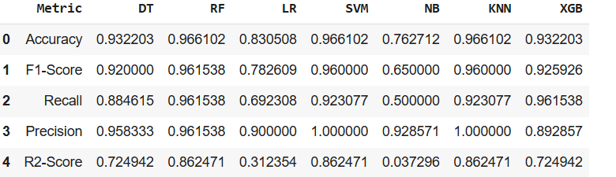
Comparision table of different machine learning models
Best Performing Machine Learning Model:
Random Forest Classifier was found to be the best performing Classifier with:
Accuracy: 0.996102
F1 Score : 0.961538
R2 Score : 0.862471

Slide 11

Applications
Early Detection and Diagnosis.
Personalized Treatment Plans.
Telemedicine Integration.
Decision Support for Clinicians.

Slide 12

FUTURE SCOPE
1. Integration with Artificial Intelligence.
2. Deploy it in a web app using streamlit for better user interface.
3. Advanced Feature Engineering.

Slide 13
BIBLIOGRAPHY
Senturk, Zehra Karapinar. "Early diagnosis of Parkinson’s disease using machine learning algorithms." Medical hypotheses 138 (2020): 109603.
An improved approach for prediction of Parkinson's disease using machine learning techniques." 2016 international conference on signal processing, communication, power and embedded system (SCOPES). IEEE, 2016.
"Early detection of Parkinson’s disease using deep learning and machine learning." IEEE Access 8 (2020): 147635-147646.
Tsanas, A., Little, M. A., McSharry, P. E., Spielman, J., & Ramig, L. O. (2012). Novel speech signal processing algorithms for highaccuracy classification of Parkinson's disease. Biomedical Engineering, IEEE Transactions on, 59(5), 1264-1271.

Slide 14
Thank You

